Slide 1
Lesson 1 - Day 3

Slide 2
Lesson Overview
Day 3
Stop and Think- introduction to MEME 3 mins
MEME instructions- how to make a model on MEME 20
Make a model on MEME- students will make the class consensus model on MEME 25
Before you go- assess the class consensus model according to the criteria list 2 mins
Total time: 50 mins

Slide 3
STOP & THINK!
Grab a handout and put your name and information on the top of the first page.
Complete the STOP & THINK! question on the first page.
Today we will be using a new app called MEME.
Can you guess what MEME stands for?
M_______
E________
M_______
E________
Notes:
BEGINNING OF DAY 3
Today students will learn how to use MEME, an online tool for building models. The instructions for how to use MEME are in this PowerPoint and on their handout.
MEME stands for
Modeling and
Evidence
Mapping
Environment

Slide 4
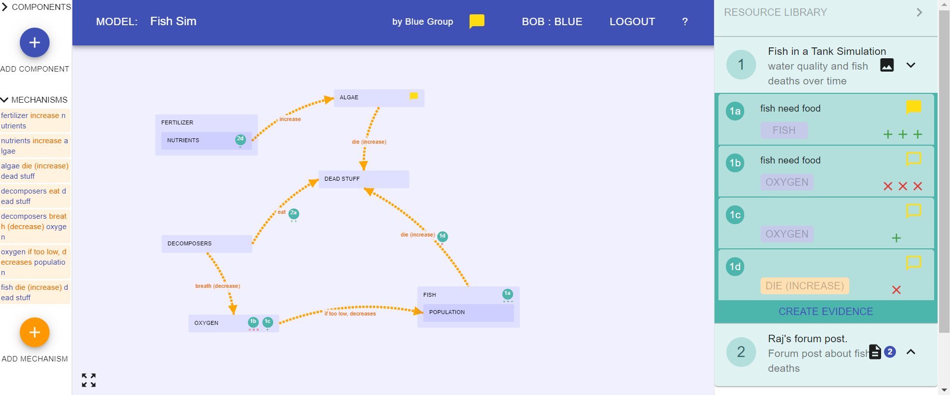
MEME
Now we’re going to use a brand-new app called MEME!
You can use it to make models on the computer, just like scientists!
Let’s learn how to use it…
Notes:
Students need Chromebooks, one for each pair
Open Chromebook to MEME
Input Code to login. Will see the purple page shown above

Slide 5
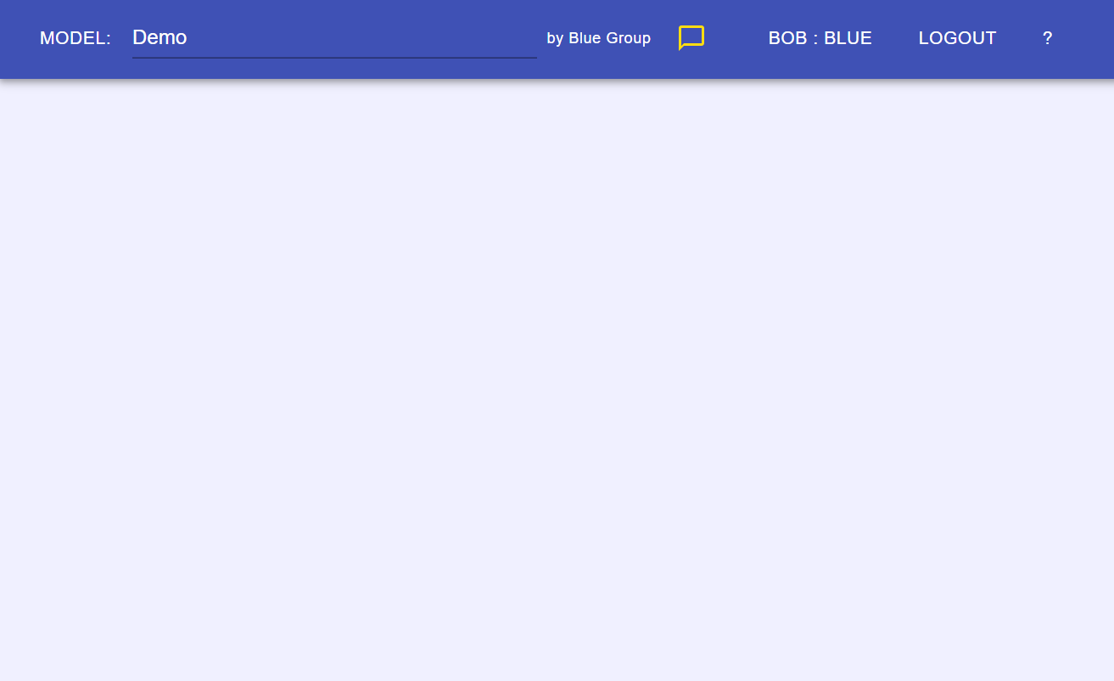
MEME – Basic Information
At the top, we have an information bar. Here you can see:
The name of the model
Who made the model
You, and your group
Comments
Help/info
Notes:
Need to have the steps from the very beginning in terms of logging in… step by step to even get to this screen
Go through each part, one by one. This slide is animated to show the parts.

Slide 6
Making a model…
MEME
Notes:
Slides from here on show how to make a model step by step

Slide 7
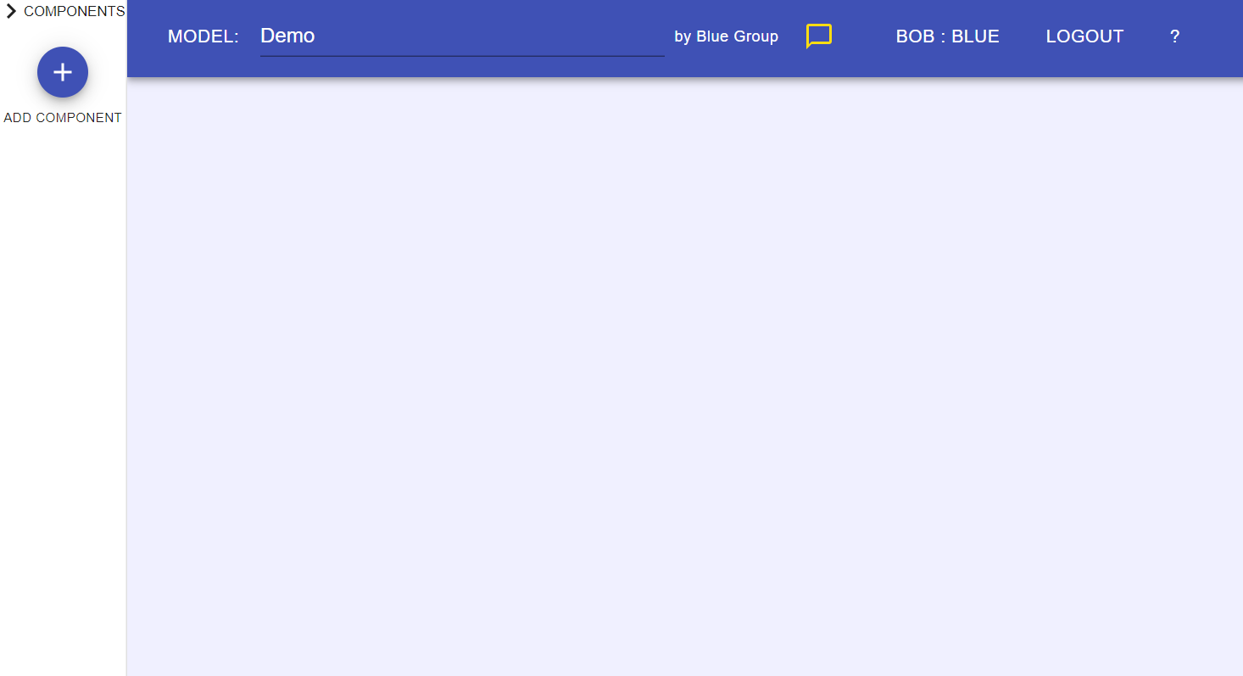
Making a model
Add a component
Notes:
Tell students that a component is a piece of the model, like fish, water, or air.
The plus sign means add a component (or piece)

Slide 8
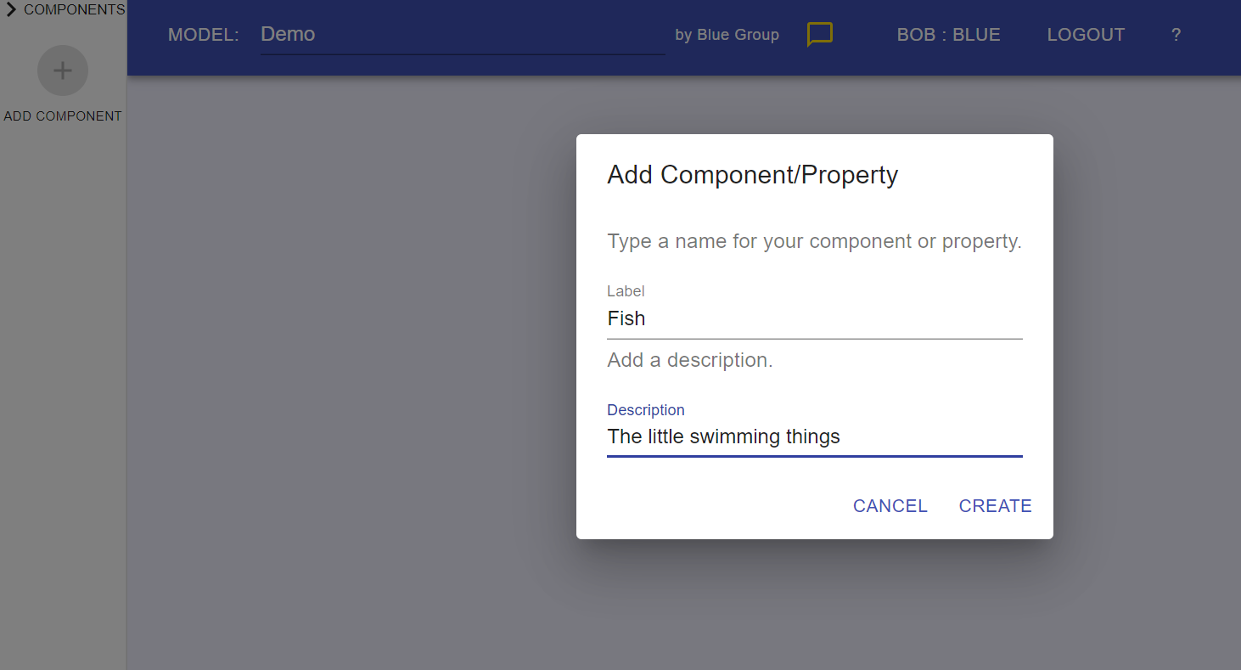
MEME – Making a Model
Add information
Create!
Notes:
This slide is animated.
Remind students that they can both label the component and describe it. Tell them that the description will help make sure that other people who see the model will know what they mean. This might be obvious for a component like fish, but less obvious for something like waste (this is just for your reference)

Slide 9
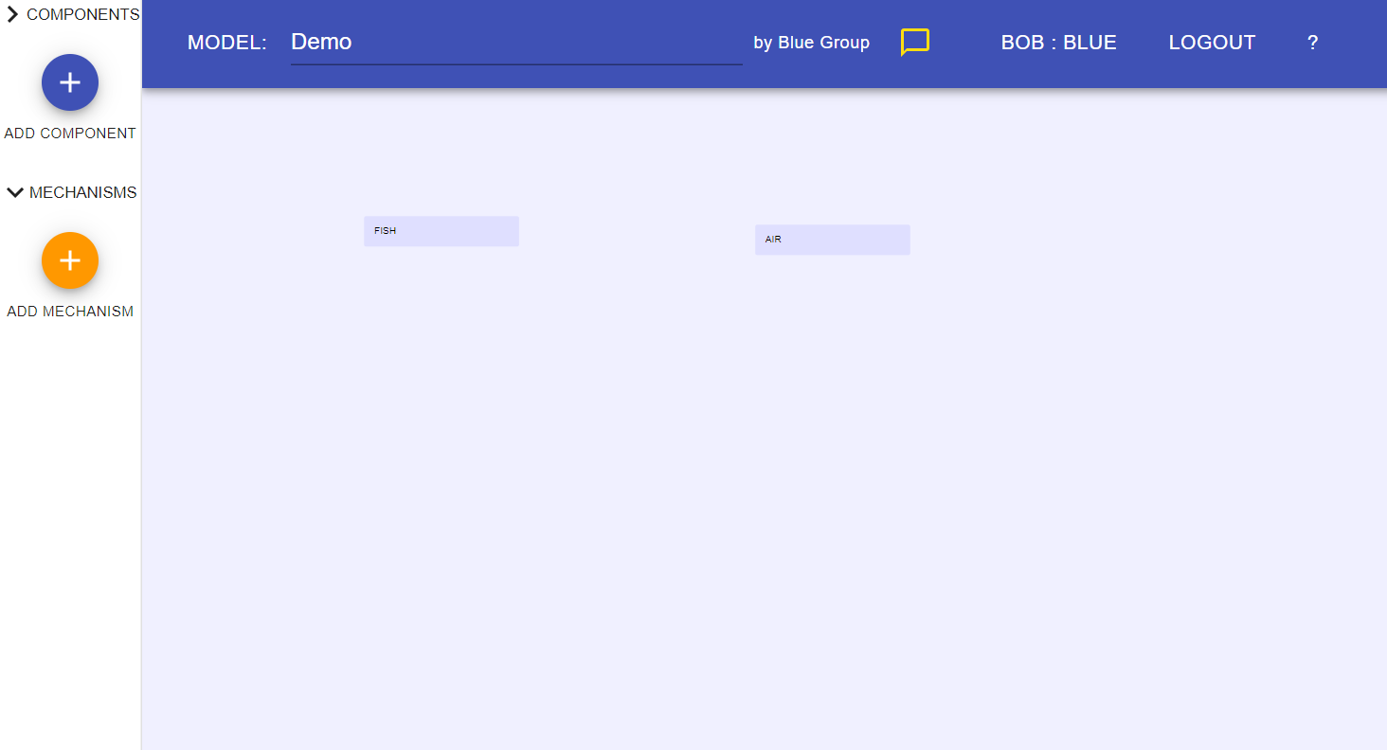
MEME – Making a Model
Now that there are two, we can connect them
It appeared!
Now we can add another!
Notes:
This slide is animated.
Go over how to add another component and connect them with a mechanism.
Tell students that a mechanism shows how different components affect one another. For example, fish can SWIM in the water, fish EAT food. Ask one or two kids to give another example of a mechanism. The mechanisms show how components are connected or how they interact.

Slide 10
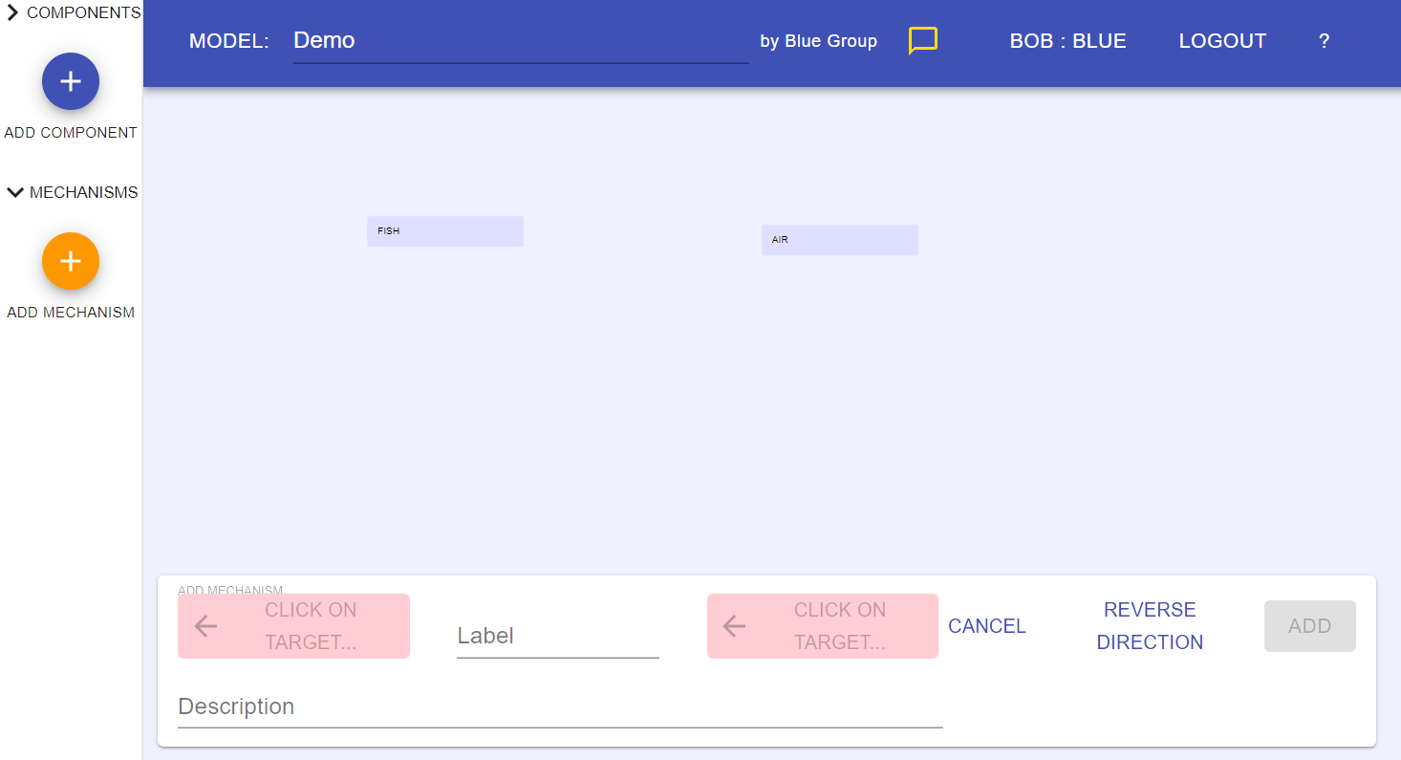
MEME – Making a Model
Arrows describe how the source affects the target
Source
Target
Notes:
This slide is animated.
When we click add a mechanism, we choose the source and the target.

Slide 11
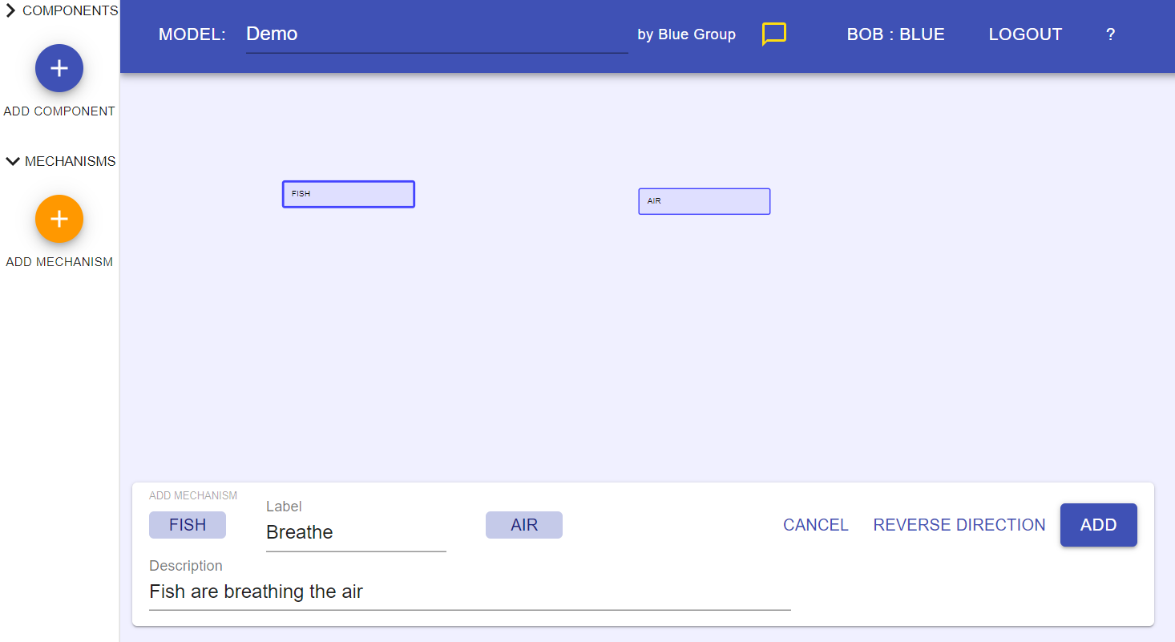
MEME – Making a Model
Add
Notes:
Ask students what they think will happen when we click “add”. Keep it brief. (an arrow appears to connect the components)

Slide 12
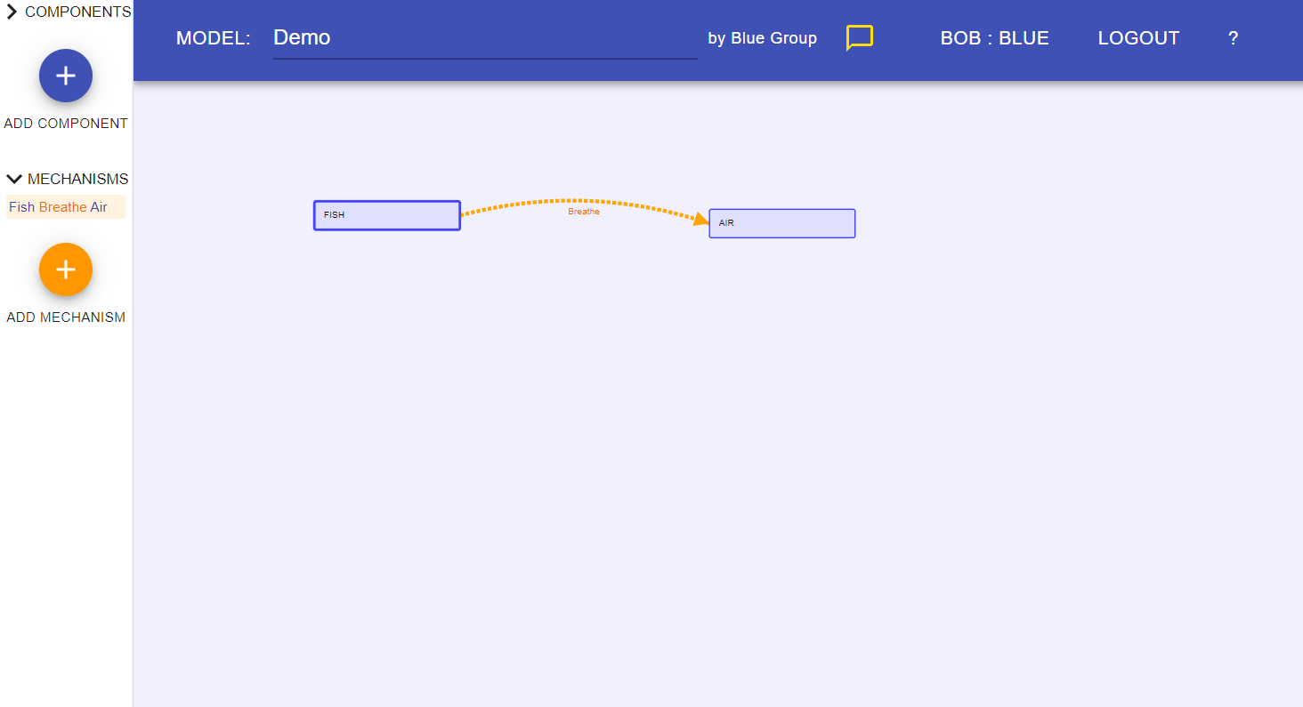
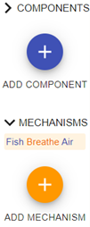
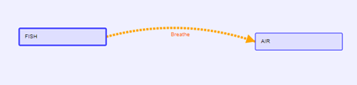
MEME – Making a Model
There it is!
We can also see it here.
Notes:
On the left side of the screen, the components and mechanisms are listed so students can see them at all times.

Slide 13
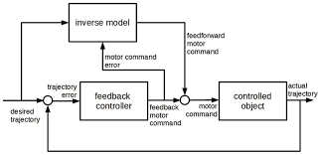
Consensus Model
Make the class consensus model on MEME.
Look at handout for directions.
Ask questions.
Notes:
Briefly review the class consensus model from last day.
Tell them that we will be using computers today to build this model on a new app

Slide 14
BEFORE YOU GO
Grab a note and put your name on it.
Complete the BEFORE YOU GO questions.
Looking at our class model, suggest one thing that would make it better.
Hint: Look at our class criteria for good models to get some ideas!
Notes:
END OF DAY 3
Use this “Before You Go” as an exit ticket.
Tell students they will be figuring this out in future classes.
Do not hold a class discussion at this point, and keep it brief at the end of class.

